Slide 1
MVC VIEW , RAZOR SYNTAX & PARTIAL VIEW

Slide 2
What is MVC View?
Definition
A View is a part of the MVC (Model-View-Controller) pattern in ASP.NET.
It is responsible for rendering HTML content to the user and presenting data to the client.
Views receive data from the controller and present it in a user-friendly format.
Purpose
Views in MVC separate the UI from the application logic.
They display data and interact with the user, often using HTML, CSS, and JavaScript.

Slide 3
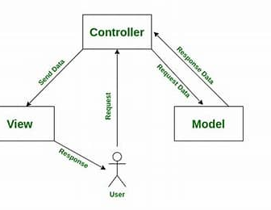
How MVC View Work
The controller returns a view that may contain dynamic content based on the model data
Views are typically returned using return View()

Slide 4
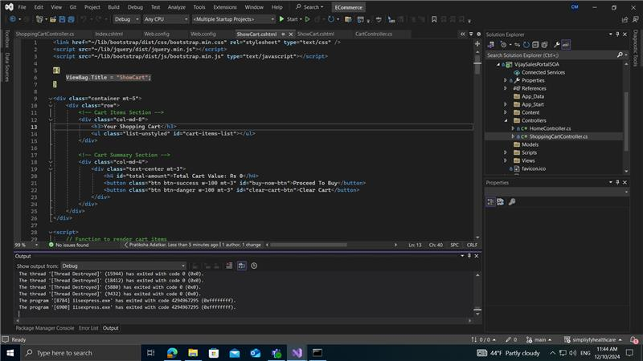
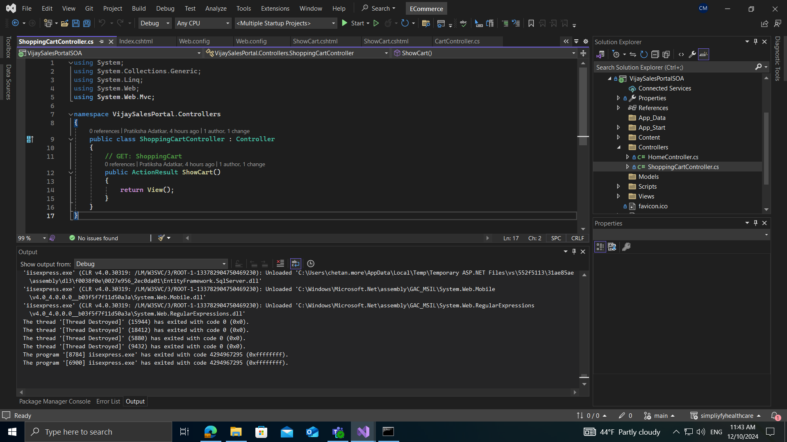
Example

Slide 5
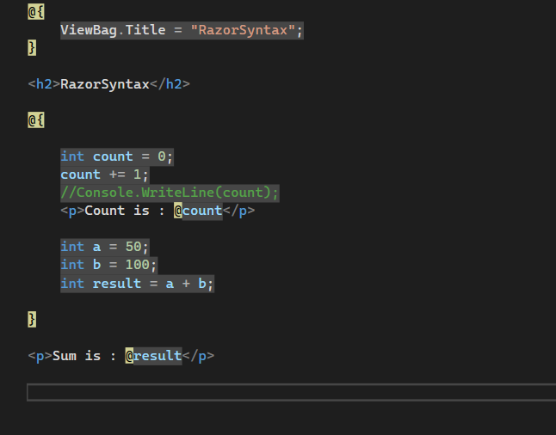
What is Razor Syntax?
Definition: Razor is a markup syntax used to embed C# code within HTML.
It allows the mixing of server-side code (C#) and HTML in a simple, clean, and readable way.
Characteristics:
Razor syntax begins with an @ Symbol
Inline C# code is placed within @{ }.
Razor is used in .cshtml files

Slide 6
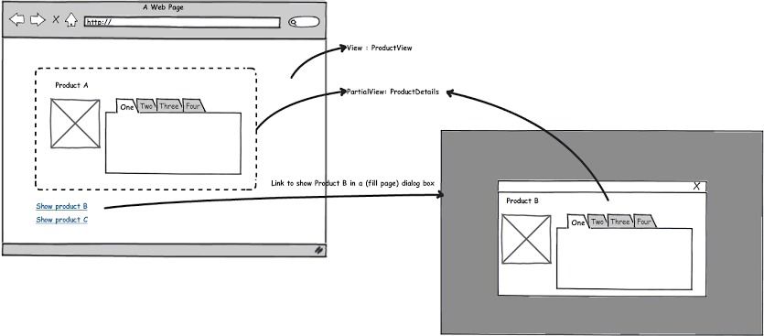
What are Partial Views?
Definition
A Partial View is a reusable, smaller portion of a view that can be embedded within a parent view.
It is typically used for rendering common UI elements (like navigation bars, footers, or product lists).
Purpose
Modularity: Reuse common UI elements across different pages.
Performance: Load only parts of the view dynamically (without refreshing the entire page).

Slide 7
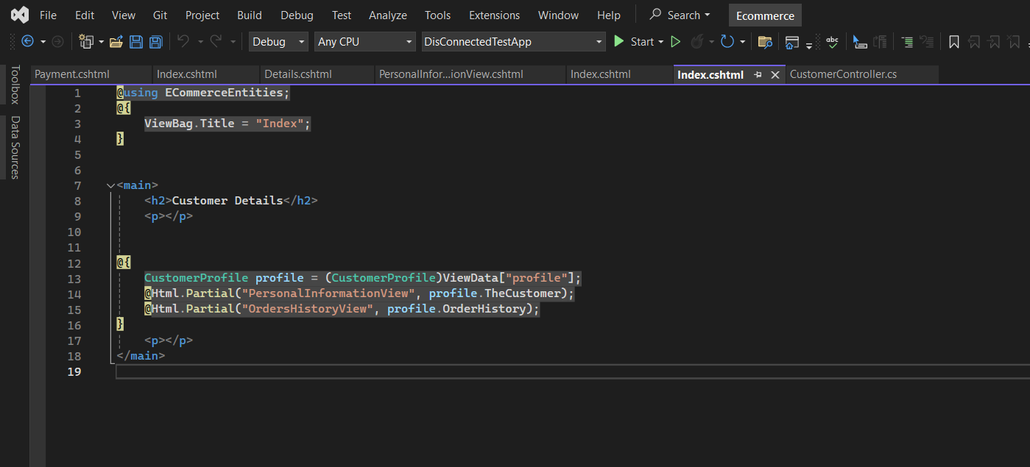
Example

Slide 8
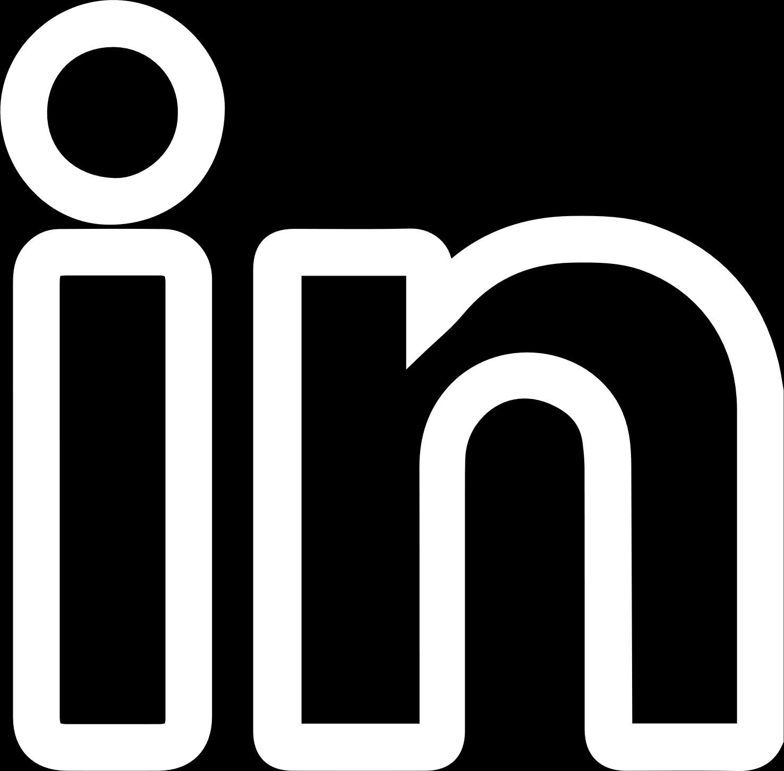
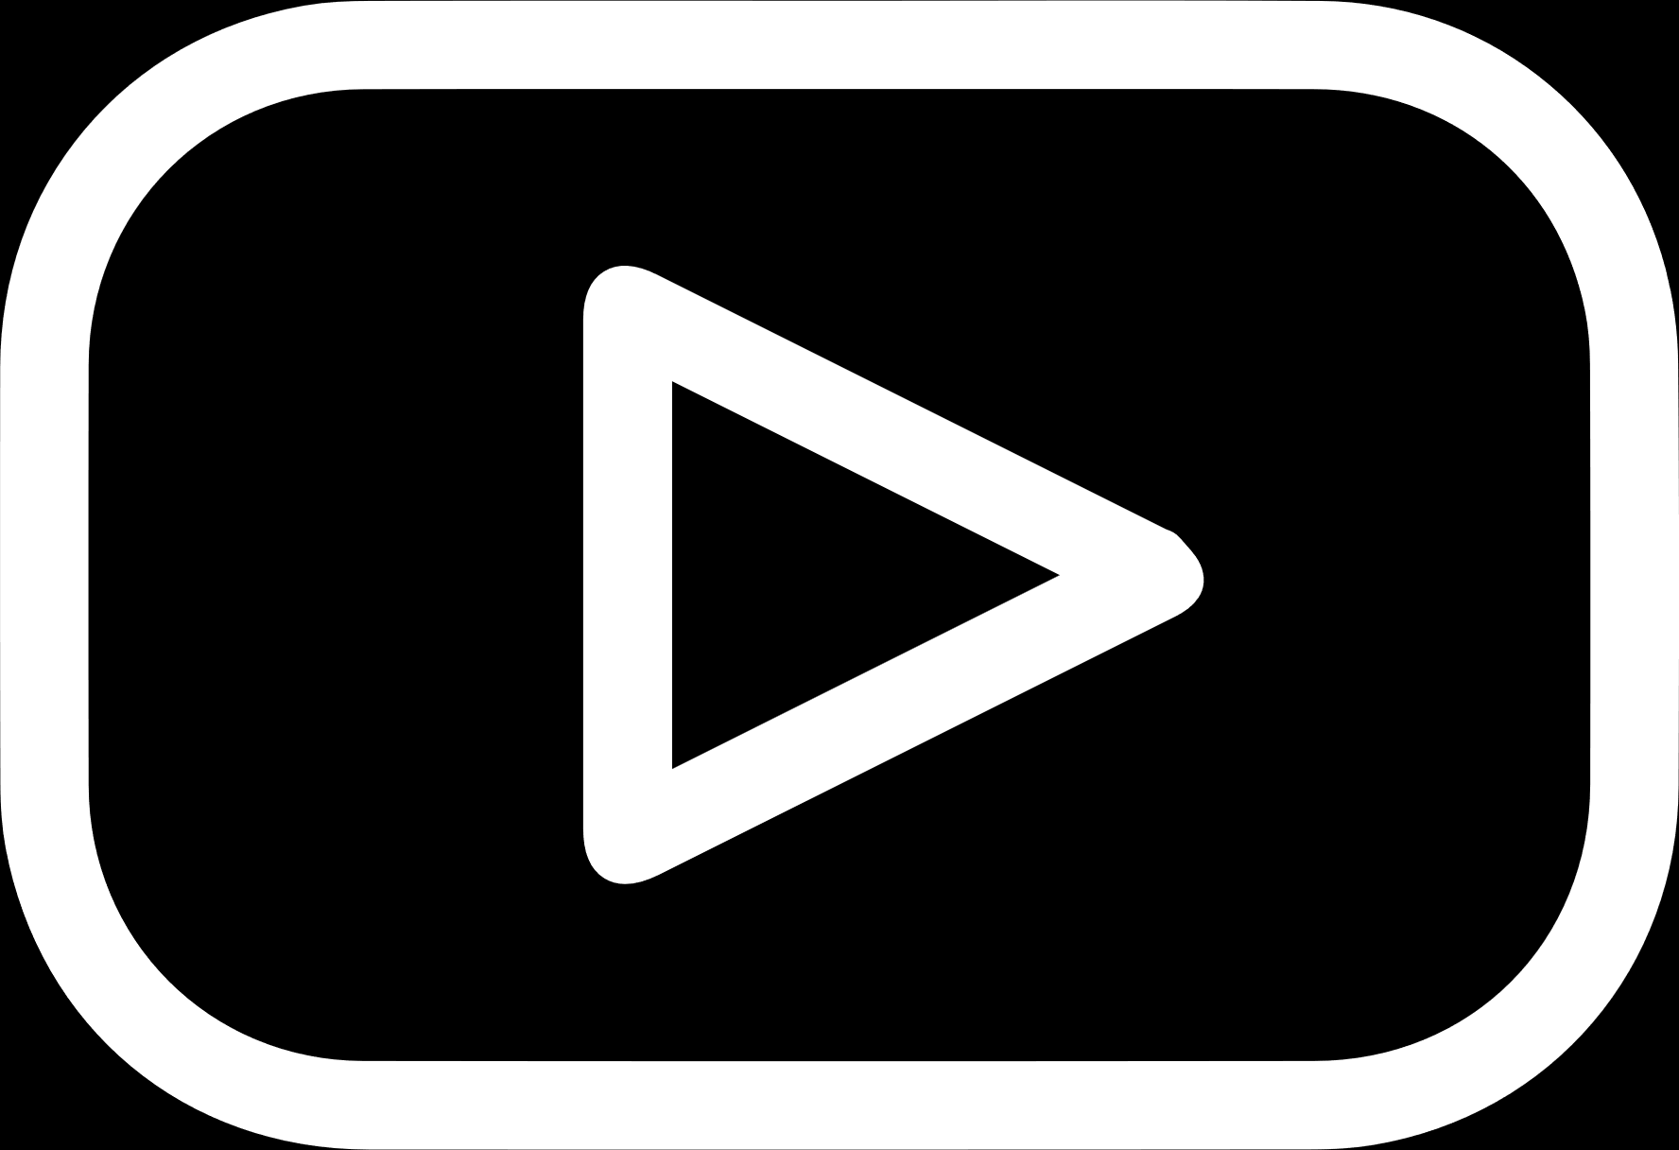
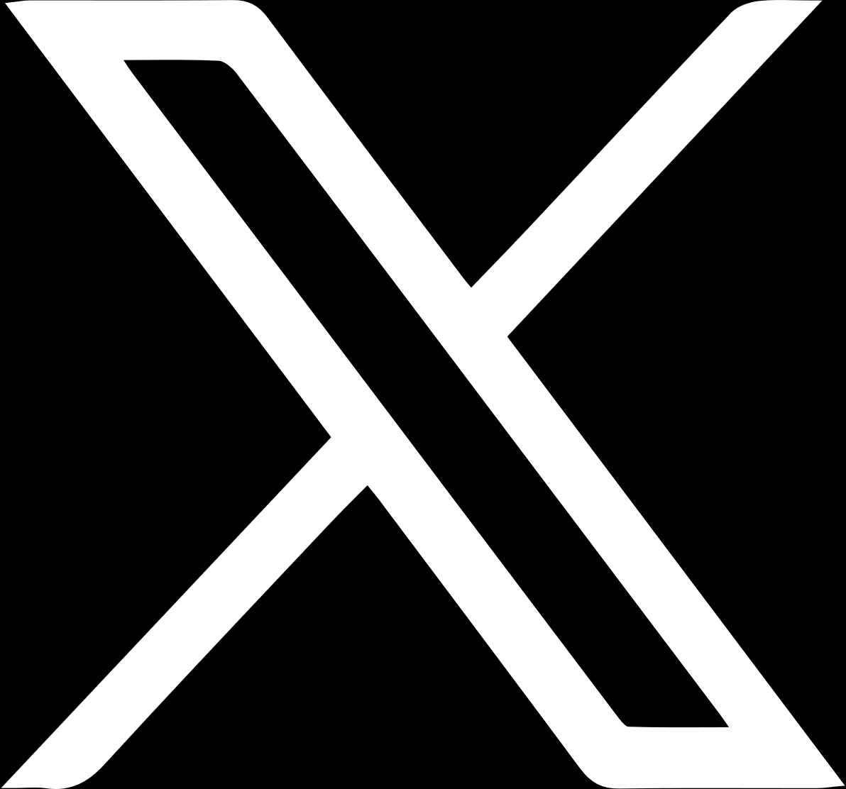
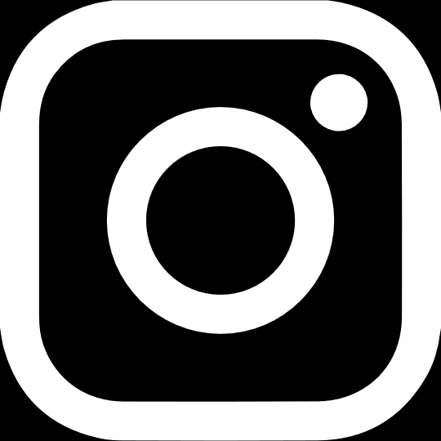
THANK YOU
(844) 720-6678
info@simplifyhealthcare.com
simplifyhealthcare.com
Simplify Healthcare
U.S.: 600 N Commons Drive, Suite 110, Aurora, IL 60504
India: 401/402, 4th Floor, Pentagon P-2, Magarpatta City, Pune 411013
CONNECT WITH US
LinkedIn
YouTube
X
Instagram

